Slide 1
Summary Statistic Tables
Siddhartha Lewis-Hayre

Slide 2
Summary stats are difficult
Problem: Summary stats in STATA (and others) are difficult
Requires manual work
What if underlying data changes?
Formatting challenges
Adding a new statistic
Compare control vs treated group
Rounding
Solution: use python functionality
Make edits in a simple text file
Run directly from command line
Automatically produces Latex file and PDF

Slide 3
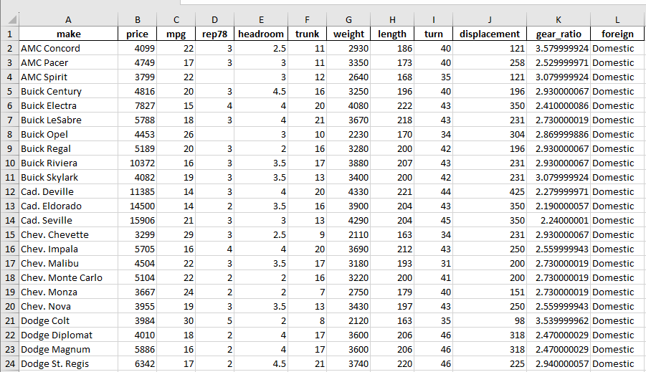
Sample data: STATA default dataset
STATA code: sysuse auto

Slide 4
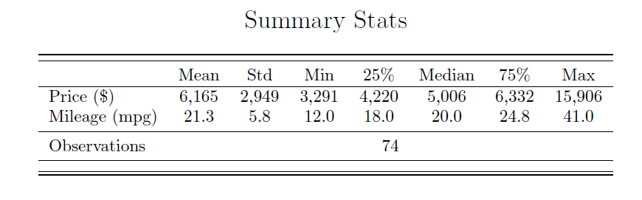
Summary Stats: Simple

Slide 5
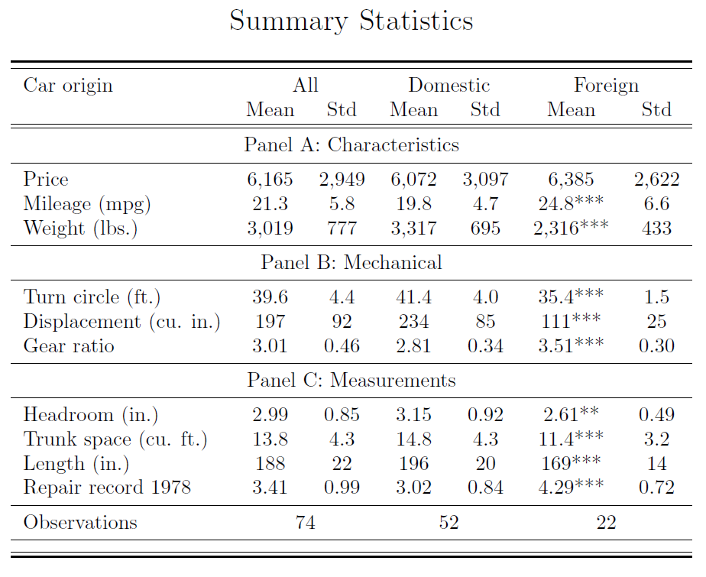
Summary Stats: Grouped Panels

Slide 6


What will the tool produce?
Latex file and compiled PDF

Slide 7
How to use the tool
Copy template to new file path
Change data location; choose variables and statistics
Open salt and run with simple command

Slide 8
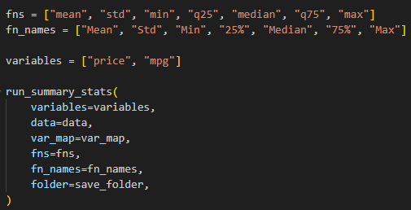
Template 1: Simple

Slide 9
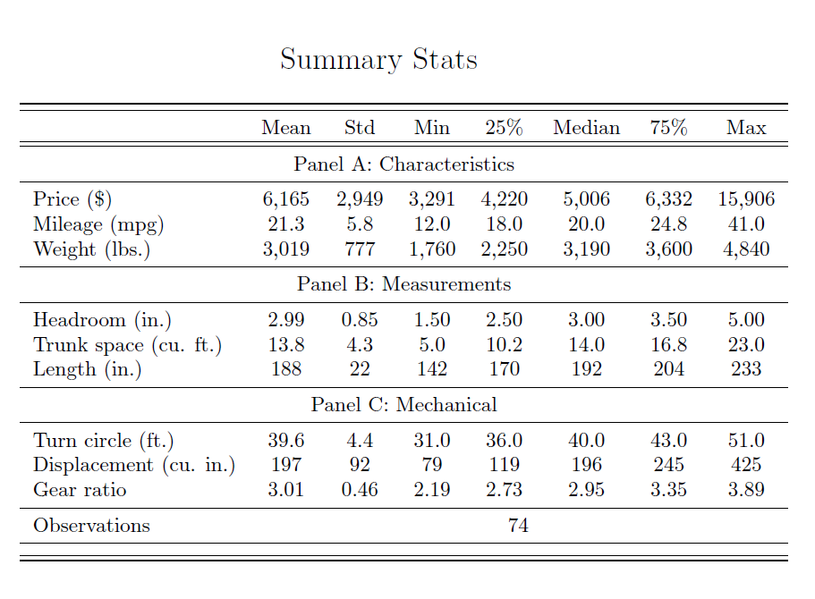
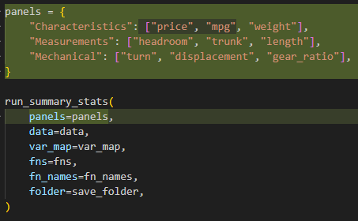
Template 2: Panels

Slide 10
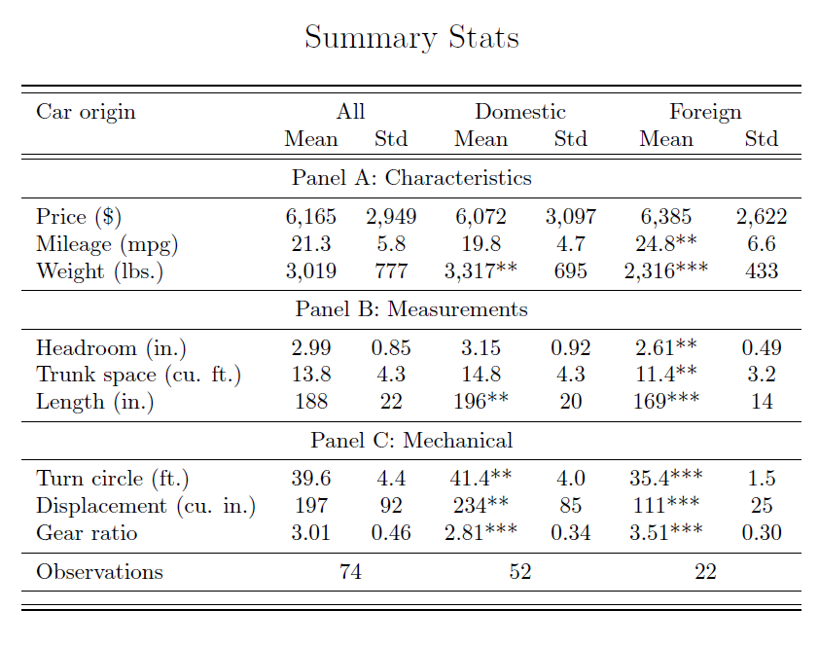
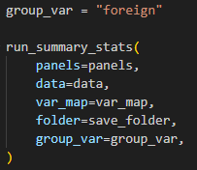
Template 3: Grouped

